Slide 1
The Amazing World of Hoppers
By
James taylor

Slide 2
What going on?
Base etchant is on the way – Thank Tian!
Trying to get access to an AFM, that won’t cost an arm and leg.
Trying to find a way to reduce static charge – Crazy idea: Ground the hopper.
Going to meet with Christine Roeger next Tuesday about getting a glass funnel made for us.

Slide 3
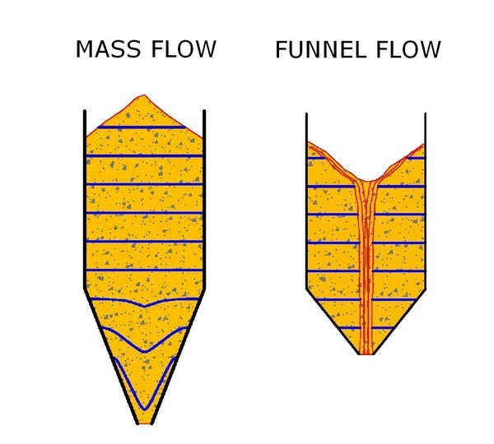
Cool Thing I learned!
There are two types of flow patterns: mass flow and funnel flow
Mass flow
First in first out flow pattern. Movement everywhere including the walls.
Funnel flow
First in last out flow pattern. Stagnation on the sides due to material not moving along the walls. The material flows through a self made funnel (rat-hole).

